Slide 2
.NET Today and Tomorrow
Jon Galloway – Executive Director, .NET Foundation
@JonGalloway
Beth Massi – Product Marketing Manager, .NET Platform @BethMassi

Slide 3














Your platform for building anything
DESKTOP
WEB
CLOUD
MOBILE
GAMING
IoT
AI
.NET
Notes:
You can build anything with .NET. We’ve made significant investments in .NET over the years as well as unifying the ecosystem to support building literally anything. From desktop to gaming to the cloud, .NET is a general purpose programming platform that enables all kinds of scenarios. Once you learn one, you can easily pick up another.

Slide 4

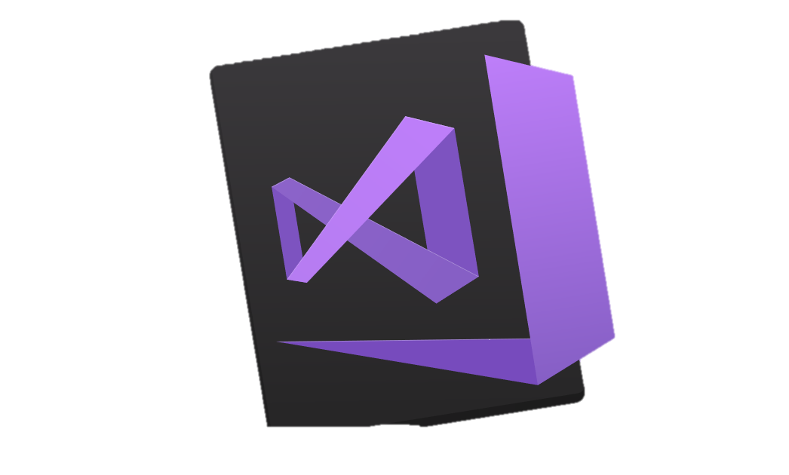


.NET – A unified platform
TOOLS
DESKTOP
WEB
CLOUD
MOBILE
GAMING
IoT
AI
VISUAL STUDIO
.NET STANDARD
VISUAL STUDIO FOR MAC
LIBRARIES
VISUAL STUDIO CODE
INFRASTRUCTURE
RUNTIME COMPONENTS
COMPILERS
LANGUAGES
COMMAND LINE INTERFACE
Notes:
.NET is an entire software development platform that takes care of a lot of the heavy lifting for you when you want to build an application. Applications frameworks help you build the specific types of apps or workloads and enable you to literally build any app for any platform with any operating system. Each .NET workload shares a common infrastructure and base libraries ad .NET Standard. This means not only are your .NET skills portable, but your actual code is portable no matter what you’re building. This makes it easy to share libraries across the breadth of applications people build.
Additionally, there are a broad set of development tools that makes it really productive to write, debug, build and manage code bases.
See: www.dot.net

Slide 5
.NET Growth Continues
Visual Studio
+1 million new monthly active .NET developers in last year
.NET Core
Over half a million .NET Core 2.0 developers

Slide 6






RayGun
"Using the same-size server, we were able to go from 1,000 requests per second per node with Node.js to 20,000 requests per second with .NET Core."
- John-Daniel Trask, CEO and Co-Founder
AstroReality, Quantum Technologies
"We think .NET Core is mature, very powerful, and a great choice for advanced modern apps."
- Zerlot Ma, Cofounder and CEO
Jet.com Inc.
"The event-driven, microservices paradigm eliminated a lot of the overhead that comes with a service-oriented architecture."
- Mike Hanrahan, CTO
Tencent
“The cross-platform capabilities of .NET Core were very important to us. Also, Microsoft designed .NET Core with a microservice architecture in mind, and that fits right in with our redesign plans.”
- Shanyou Zhang: Senior Software Architect
Age of Ascent, Illyriad Games
"Our game microservices are built using ASP.NET Core which gives us superior performance. ASP.NET is open source, that allows us to contribute back to it if we have any performance issues which Microsoft review and together we make a better product."
- Ben Adams, CTO and Co-founder
NetEase
".NET Core doesn't just help us get to market faster, it also enables our developers to focus on the core logic and what really matters, our players' experience. They don't have to deal with the communication gap and different ways of implementing the algorithm on the back and front end. They can just work on finding better ways to implement their ideas."
- Feng Zhou, Product Director
United Parcel Service (UPS)
"Xamarin allowed us to develop a single code base in C# and deploy the application to two completely different mobile phone ecosystems."
- Scott Hildebrand, Application Development Manager
GoDaddy
“Services can be developed more quickly, perform faster in production, and scale better if they’re written using .NET Core with C#.”
- Jeremiah Gowdy: Principal Software Architect
And many more: microsoft.com/net/customers
Notes:
Our customers have been embracing the productivity in our platform, languages and tools for 15+ years. We’re now gaining existing customers as well as new ones on our cloud-native, cross-platform, and device-native approaches with these new architectures. Here are just a few. There are many more (and their stories) on our website.

Slide 7

Notes:
https://www.youtube.com/watch?v=hUNKUwYH0Tg

Slide 8

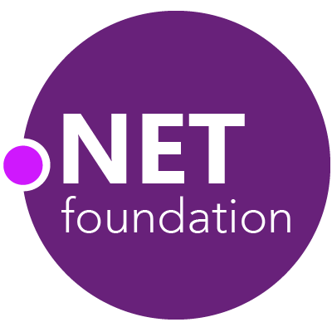
Steeltoe
.NET Core
Microsoft Web Protection Library
MSBuild
DotNetNuke
ASP.NET AJAX Control Toolkit
ASP.NET Core
SourceLink
Microsoft Azure WebJobs SDK
Salesforce Toolkits for .NET
nUnit
MVVM Light Toolkit
IronPython
Mailkit
WorldWide Telescope
Nancy
Open XML SDK
.NET SDK for Hadoop
MvvmCross
MEF
JSON.NET
Mimekit
xUnit
ASP.NET Web Pages
NuGet
IdentityManager
Couchbase Lite for .NET
ML.NET
iOS
macOS
Entity Framework
.NET ECOSYSTEM
WCF
ILMerge
Xamarin.Mobile
ASP.NET SignalR
Infer.NET
.NET Micro Framework
Open Live Writer
Mono
Xamarin.Auth
Xamarin SDK
Orchard CMS
OWIN Authentication Middleware
ProtoBuild
IdentityServer
Microsoft Azure SDK for .NET
.NET Compiler Platform ("Roslyn")
Prism
ASP.NET Web API
Cake
Orleans
Kudu
Cecil
LLILC
Umbraco
System.Drawing
ASP.NET MVC
Notes:
The .NET Foundation is our center of gravity for open development and collaboration around the .NET ecosystem. The .NET Foundation has over 50 projects and hundreds of repos under its stewardship. Open Source Software foundations provide protection, support, services and best practices for helping each project be successful and to grow the ecosystem of people and software.

Slide 9
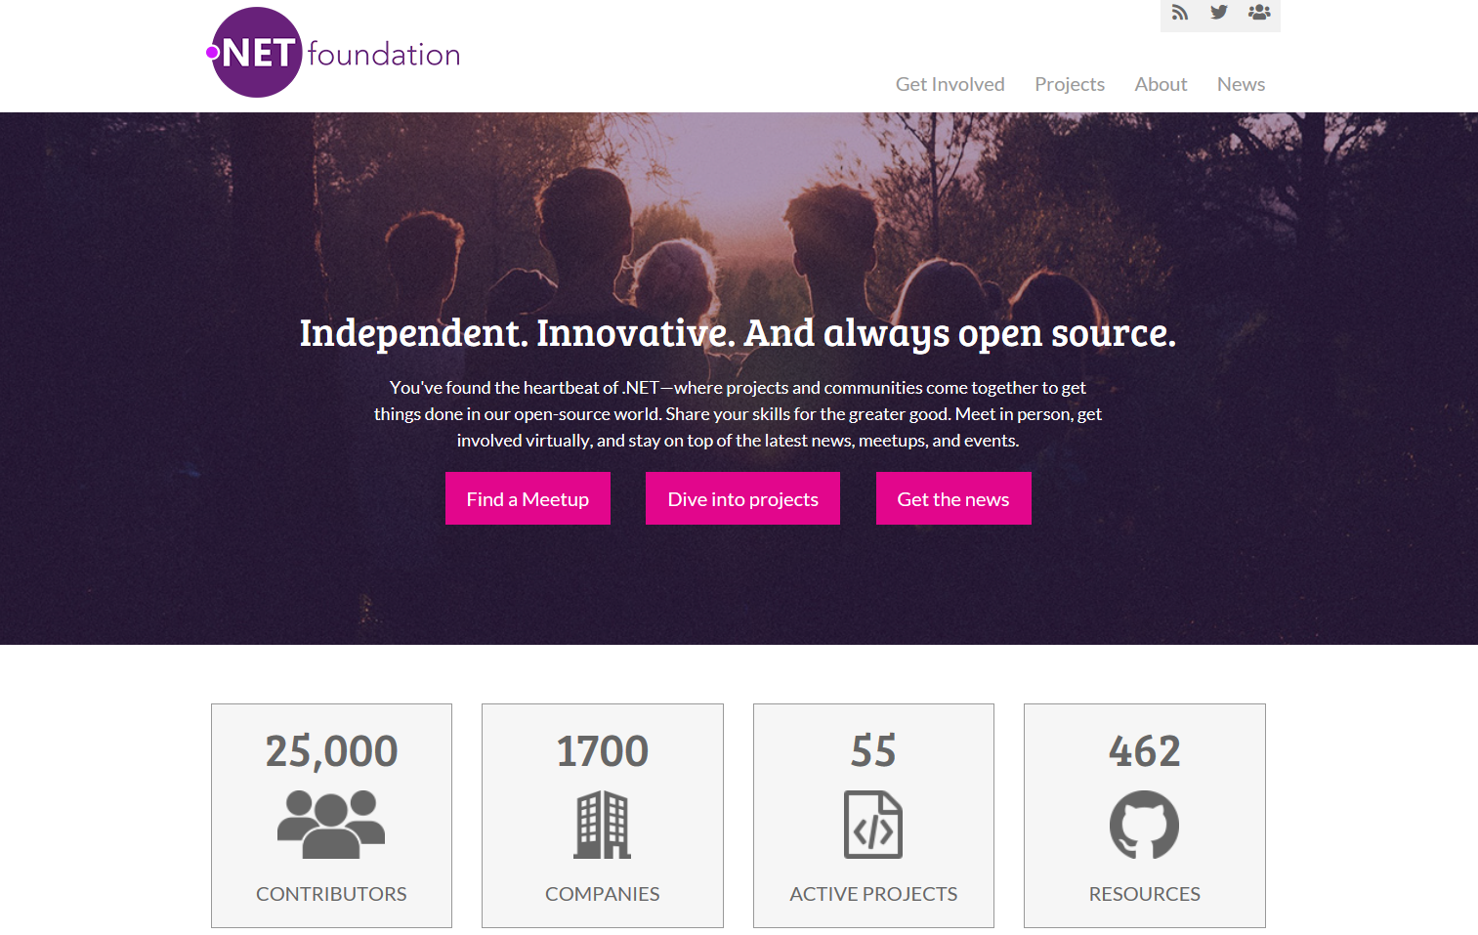
www.dotnetfoundation.org
Notes:
The ecosystem starts with you! Get involved by joining (or running!) a meetup. Contribute to projects, or just read the news. Visit www.dotnetfoundation.org

Slide 10
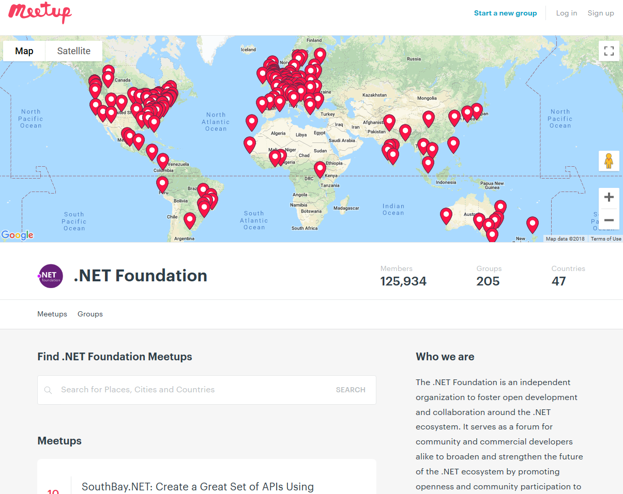
Groups
221
Members
134,509
Countries
50
Join us: meetup.com/pro/dotnet
Notes:
We’re a huge community and the .NET Foundation is key to help foster it. We have over 4 million developers worldwide and .NET has grown its developer base by 1 million over the last year. There are meetups all over the world that speak on all sorts of .NET topics and application development. Here are the ones on meetup.com.

Slide 11
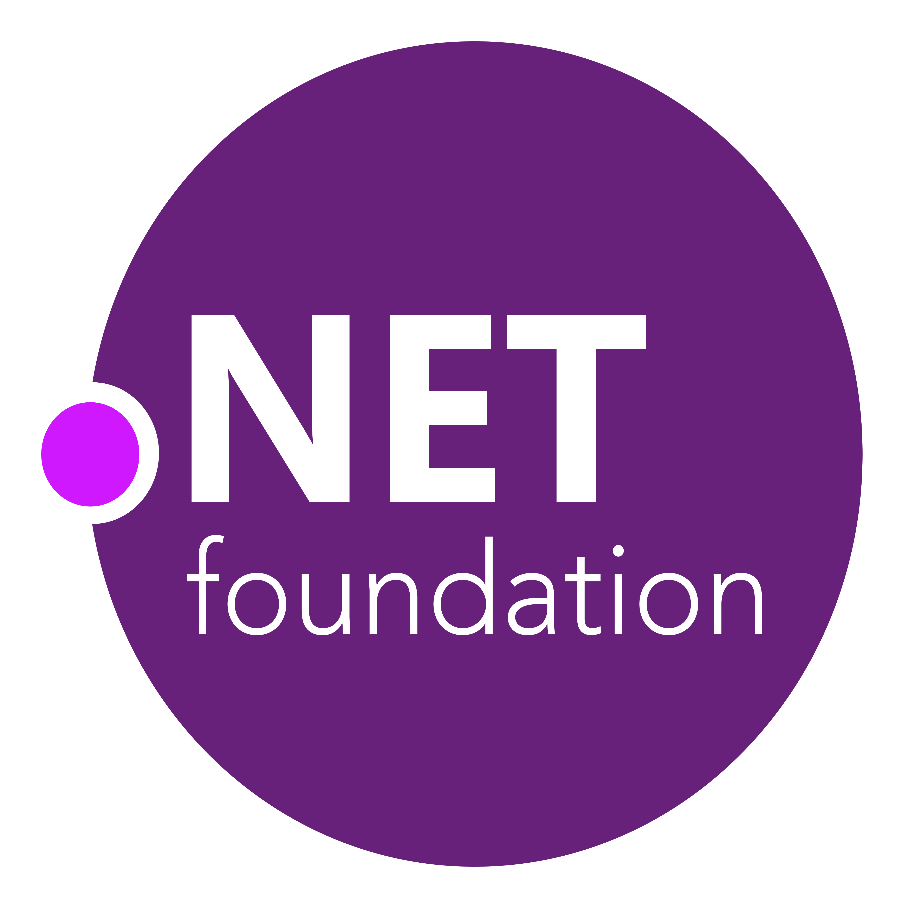

.NET Open Source Journey
.NET
2001
ECMA 335
2008
ASP.NET MVC (web platform) open source
April 2014
.NET Compiler Platform (“Roslyn”) open source
.NET Foundation founded
2016
Mono project joins .NET Foundation
June 2018
.NET Core 2.1 released
2002
NET 1.0 for Windows released. Mono project begins
Aug. 2017
.NET Core 2.0 released
Nov. 2014
.NET Core (cross-platform) project begins
Notes:
Dec 2001-Feb 2002.
A new platform is born. Along with HP, Intel and others, the ECMA-335 standard was created that defined a common language infrastructure to support multiple programming languages. C# and Visual Basic.NET were released and F# came later in 2007, but there are over 20 other .NET languages today. Visual Studio .NET was released and included C#, VB, C++ development all in one box. This was the first IDE that was truly integrated across multiple languages.
Mono project begins. The CLI spec gave others the ability to create their own .NET implementations. Even though Microsoft built the first .NET Framework for Windows-only, the spec was intentionally portable across OSes and chipsets. The Mono project began, spearheaded by Miguel de Icaza, with the goal to implement Microsoft's new .NET development platform on Linux and Unix-like platforms. Later, Miguel started Xamarin which focused on cross-platform, native, mobile development with C#, built upon Mono. This allows developers to use C# and .NET to build apps for iOS and Android. Unity games development also emerged from Mono.
2008.
ASP.NET MVC web development stack is released to CodePlex as open source. This was the first application development framework from Microsoft to be released as open source. The underlying runtime and compilers were still closed however.
2014.
Hell freezes over & pigs fly. Early 2014 at Microsoft’s BUILD conference, Anders Hejlsberg, the father of C#, releases the .NET Compiler Platform “Roslyn” as open source on stage. Later in November, .NET Core project begins in the open. The technology world is shocked, and the .NET community is excited. .NET Core is a new cloud-native implementation of .NET that is geared for cross-platform, hyper-scale services as well as small IoT devices. It’s meant to bring .NET into the next 15 years of computing. And the community has been extremely supportive….
2016.
Mono comes home. In early 2016, Microsoft finally acquires Xamarin and brings Miguel de Icaza into Developer Division. Mono joins the .NET foundation and is officially supported and contributed to by Microsoft. The Microsoft community officially meets the Mono community.
2017.
.NET Core 2.0 Released. Our cross platform and open source implementation of .NET finally releases to the world with unified tooling support across multiple operating systems and editors.

Slide 12

.NET Open Source Success
“Samsung is embracing .NET because it is a completely open source project.” — Samsung
".NET is open source; that allows us to contribute back to it if we have any performance issues which Microsoft review and together we make a better product.“ — Illyriad Games
20,000+ Community Contributions from 3700+ Companies outside Microsoft
Notes:
We’ve seen companies taking a bet on .NET because it’s a completely open source project now. More than 20,000 contributors* from 3700 companies have contributed to .NET Core and related open source repositories, with over half of the contributions coming from outside Microsoft.
In the last year we have seen over half a million developers use .NET Core, the cross-platform, high-performance, implementation of .NET.
*contributor = Submitted a Pull Request or Created an Issue. Data up to March 2018.

Slide 13
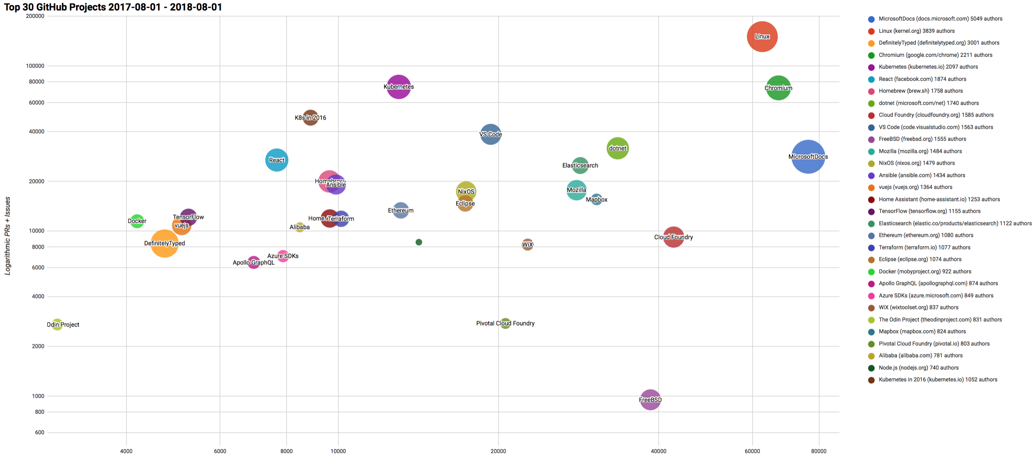

Top 30 Highest Velocity OSS Projects on GitHub
https://www.cncf.io/blog/2017/06/05/30-highest-velocity-open-source-projects/
https://raw.githubusercontent.com/cncf/velocity/master/charts/top30_20170801_20180801.png
Notes:
Jim Zemlin, Executive director of Linux foundation said “There are 10’s of millions of open source projects, invest in the ones with sustainable ecosystems”. .NET is one of those projects. CNCF tracks the top 30 highest velocity open source projects. This is a logarithmic scale to measure OSS project velocity with commits on the X axis and PRs and issues on the Y axis, with # of authors indicated by the size of the circle. The farther upper right the more activity a project has. Linux Kernel is #1, followed by Chromium, Kubernetes and VSCode. Notice .NET is the #1 application framework. And huge shout-out to the community for contributing to our docs!

Slide 14
Now Available .NET Core 2.1!
www.dot.net

Slide 15

.NET Core 2.1 Themes
Improved Compatibility with .NET Framework
GDPR & Security
Microservices and Azure
Continued Performance Improvements

Slide 16
“We are honored that Microsoft has made it a priority to improve ASP.NET’s performance in these benchmarks, and in so doing, improve the performance of all applications built on ASP.NET.
We believe this to be the most significant performance improvement that this project has ever seen.”
- TechEmpower

Slide 17
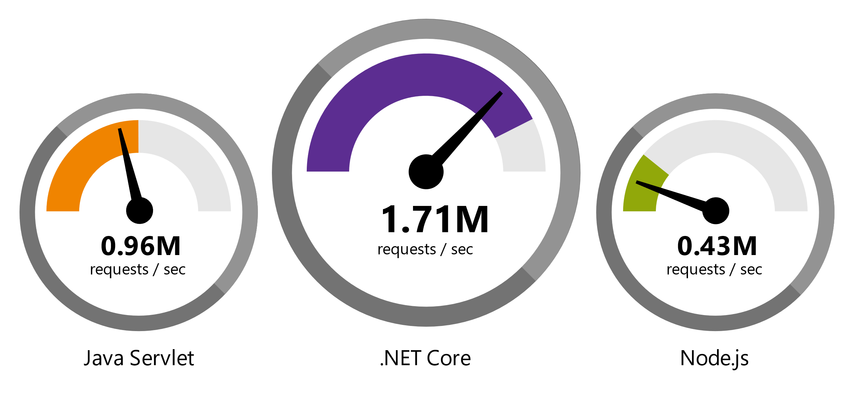
.NET is Fast
RAW PLATFORM PERFORMANCE
6.97M
requests / sec
2.55M
requests / sec
0.83M
requests / sec
Data sourced from official raw platform tests available at TechEmpower Round 16.
“Using the same-size server, we were able to go from 1,000 requests per second per node with Node.js to 20,000 requests per second with .NET Core.“ — Raygun
microsoft.com/net/customers
Notes:
.NET is fast. Really fast! That means applications provide better response times and require less compute power. The popular TechEmpower benchmark compares web application frameworks with tasks like JSON serialization, database access, and server side template rendering - .NET performs faster than any other popular framework.
https://www.techempower.com/benchmarks/#section=data-r16&hw=ph&test=plaintext
In the latest benchmarks on raw platform performance, .NET is more than 8 times faster than Node.js

Slide 18
.NET Core 2.1 on TechEmpower
REQUESTS / SECOND
+15%
+18%
+147%
Data sourced from official tests on TechEmpower round 16.
Notes:
These numbers show the micro framework tests (as opposed to the raw platform tests) which makes them more realistic.
Call out the incredible performance increase in the REAL WORLD data access scenario.

Slide 19
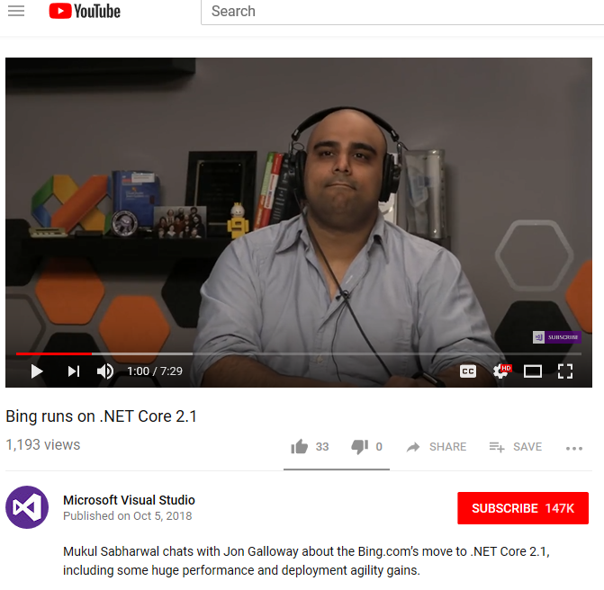
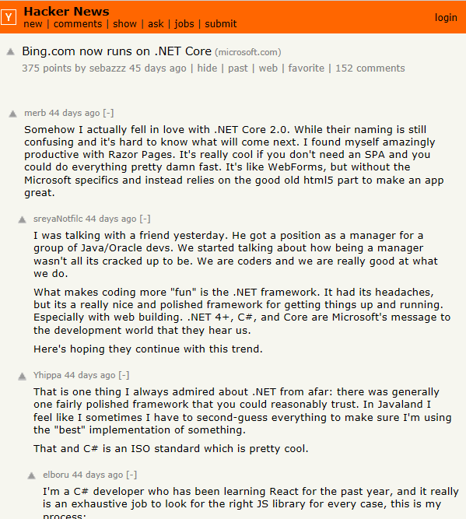
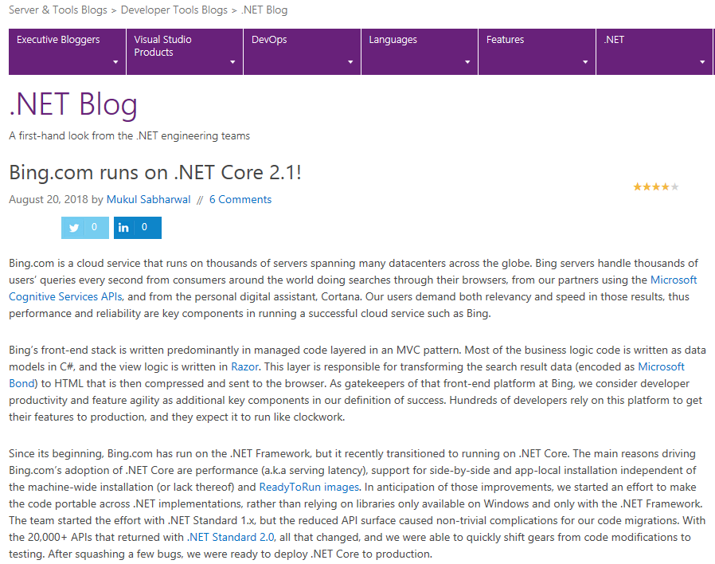
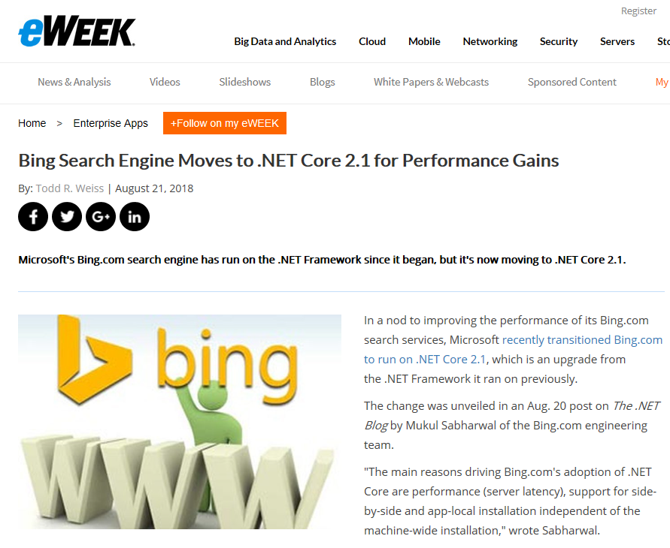
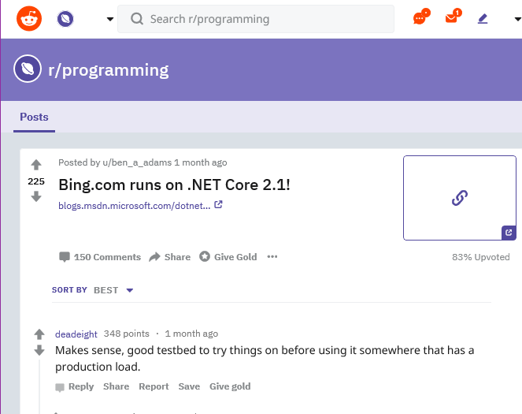
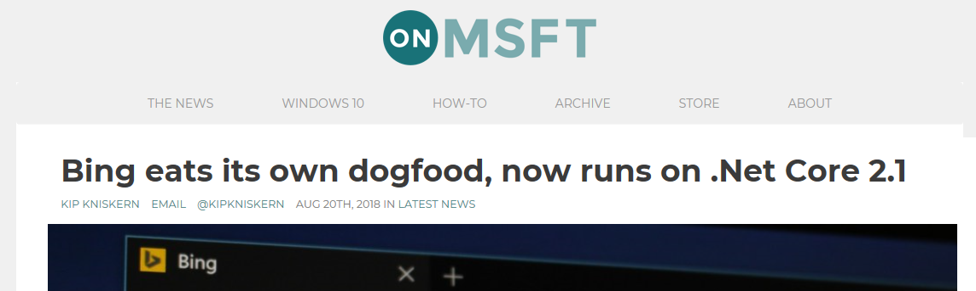
Bing.com Runs on .NET Core 2.1
Notes:
Bing.com moved to .NET Core 2.1 and saw incredible performance gains. It made a wave of news. Check out the interview with the lead engineer: https://channel9.msdn.com/Events/dotnetConf/2018/S318

Slide 20
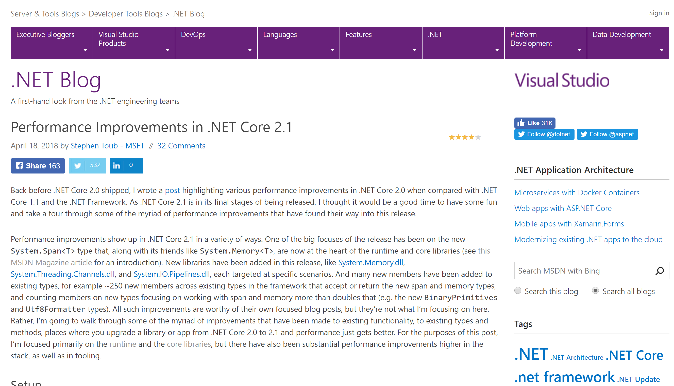
aka.ms/dotnetperf
Notes:
Here is a blog post that details the performance improvements with Span<T>

Slide 21
Performance - Span<T> and Friends
var arr = new byte[10];
Span<byte> bytes = arr; // Implicit cast from T[] to Span<T>
Span<byte> slicedBytes = bytes.Slice(start: 5, length: 2);
slicedBytes[0] = 42;
slicedBytes[1] = 43;
Assert.Equal(42, slicedBytes[0]);
Assert.Equal(43, slicedBytes[1]);
Assert.Equal(arr[5], slicedBytes[0]);
Assert.Equal(arr[6], slicedBytes[1]);
slicedBytes[2] = 44; // Throws IndexOutOfRangeException
bytes[2] = 45; // OK
Assert.Equal(arr[2], bytes[2]);
Assert.Equal(45, arr[2]);
TLDR: Manipulate a chunk of data without copying it

Slide 22
Example: StringBuilder
private static readonly StringBuilder s_builder = new StringBuilder();
public void StringBuilderAppend()
{
StringBuilder sb = s_builder;
sb.Length = 0;
for (int i = 0; i < 100_000; i++)
sb.Append(i);
}
Toolchain | Mean | Allocated
.NET Core 2.0 | 6.523 ms | 3992000 B
.NET Core 2.1 | 3.268 ms | 0 B

Slide 23
Example: Strings
public string StringToLowerChangesNeeded() =>
"This is a test to see what happens when we call ToLower.".ToLower();
public string StringToLowerAlreadyCased() =>
"this is a test to see what happens when we call tolower.".ToLower();
Method | Toolchain | Mean | Allocated
StringToLowerChangesNeeded | .NET Core 2.0 | 187.00 ns | 144 B
StringToLowerChangesNeeded | .NET Core 2.1 | 96.29 ns | 144 B
StringToLowerAlreadyCased | .NET Core 2.0 | 197.21 ns | 144 B
StringToLowerAlreadyCased | .NET Core 2.1 | 68.81 ns | 0 B

Slide 24
.NET Core 2.1 Major Features
.NET Core
Lazy Loading
Value conversions
Query types
Data seeding
ASP.NET Core
Global Tools
Span<T>
Sockets
HttpClient Performance
Windows Compatibility Pack
EF Core
HTTPS
Razor UI as a library
HttpClientFactory
ASP.NET Core SignalR

Slide 25
New in ASP.NET Core 2.1
SignalR
Razor class libraries
Identity UI library & scaffolding
HTTPS
GDPR
MVC functional testing
[ApiController], ActionResult<T>
IHttpClientFactory
Kestrel on Sockets
Generic host builder
Performance
Updated SPA templates

Slide 26
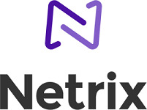
Azure SignalR Service
Add real-time web functionalities easily with Azure and .NET Core
Enable via “services.AddSignalR().AddAzureSignalR()”
Fully managed service
“By using Azure SignalR Service, we gain the best practices of built-in security and scalability—a comfort for our clients and a huge win for us.” - Lars Kemmann: Solutions Architect, Netrix
No more worries about capacity provisioning, scaling, or persistent connections
Native SignalR development
</>
Use ASP.NET Core SignalR to build real-time experiences such as chat, stock tickers, live dashboards, and instant broadcasting

Slide 27










Azure is YOUR cloud
.NET cloud apps run best in Azure
Azure Storage
Azure Cosmos DB
Azure App Service
Azure Functions
Azure App Insights
Azure Service Fabric
Azure SignalR Service
Azure Virtual Machines
Azure SQL Database
Azure Cognitive Services
Azure Kubernetes Service (AKS)
And many more…
Extend apps with serverless, event driven tasks
Commoditized AI
Fully managed platform perfect for running .NET Framework and .NET Core web aps and services
Application performance and usability monitoring
Build native .NET, fully managed, scalable microservices
Relational Database
Non-Relational Database
Fully managed real-time web functions, like chat, gaming, tickers, collaboration and more
Store anything. Great for binaries
Container orchestrator for Linux workloads (.NET Core)
Notes:
Azure is the .NET developer’s cloud. There are hundreds of developer services accessible to C# developers. From fully managed platform as a service with App Service, to serverless event driven Azure functions to relational and non-relational databases, the .NET developer is a primary target customer. We make developing against these services as integrated and productive as a .NET developer would expect.

Slide 28
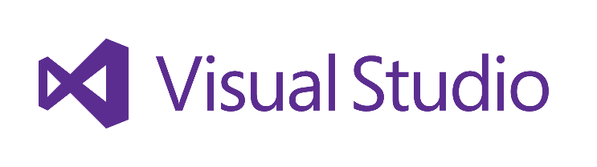
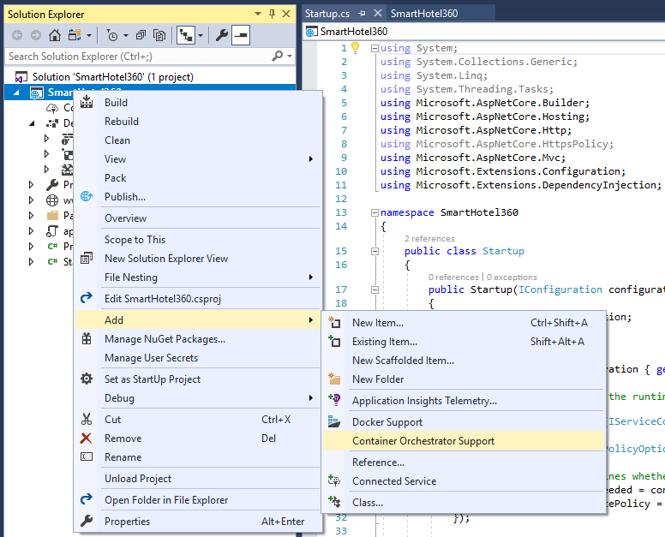
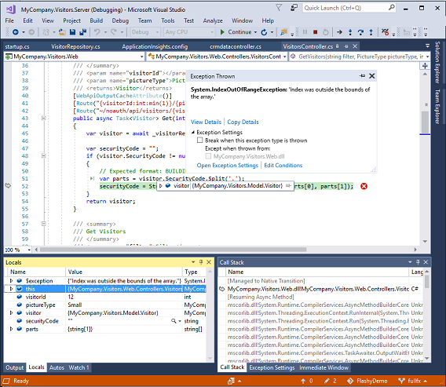
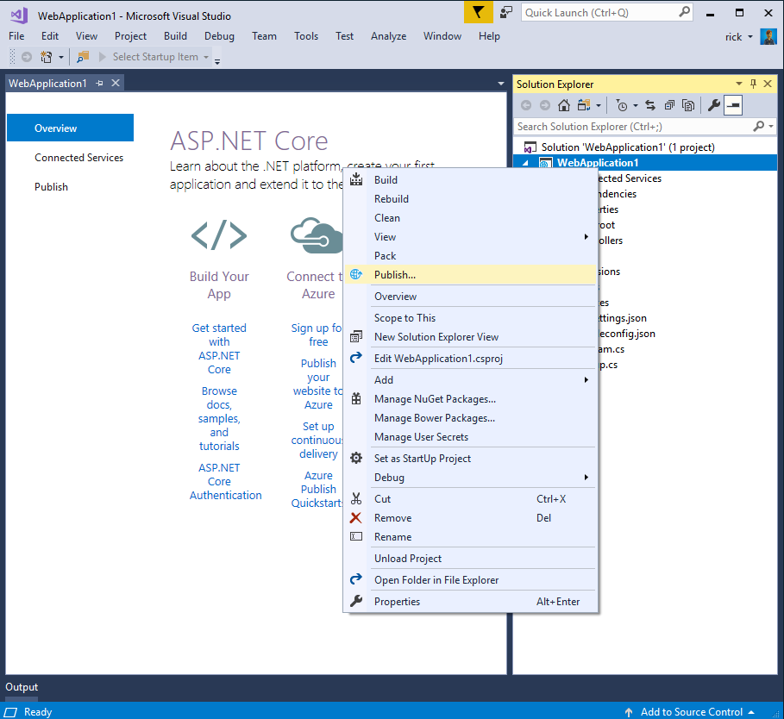
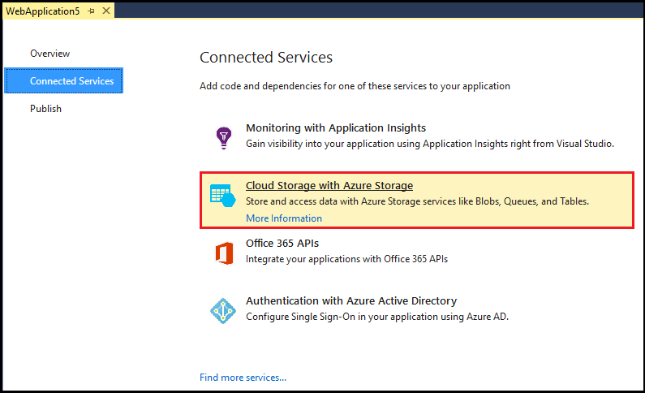
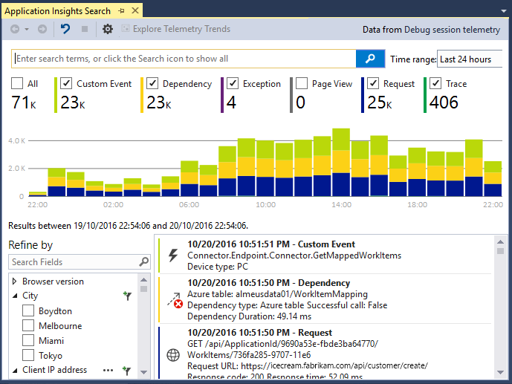
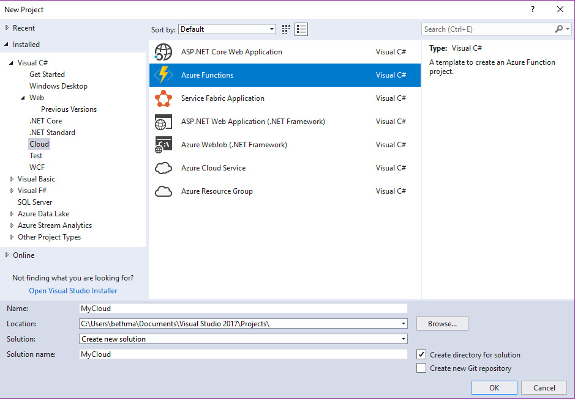
Accelerate your
development
cloud
Seamless Azure Integration
Publish directly to Azure without leaving the IDE
Connected Services
A new experience for easily discovering and extending your app with cloud services
Container Tools
Quickly add Docker compose and container orchestrator support to your apps
App Insights with Code Lens
Get a 360° view of your app that includes availability, performance and user behavior
Azure Functions
Get started quickly with serverless using templates and tools for development and debugging
Snapshot Debugging
Production debugging your cloud apps has never been so simple
Notes:
Of course there are a lot of great tools in Visual Studio for building applications. But what’s even better is the latest tools for building, monitoring, and managing your cloud applications. Whether that’s web applications hosted in App Service, or serverless Azure functions with C#, or containerized apps with Docker, we have you covered.

Slide 29
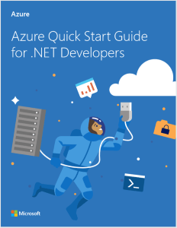
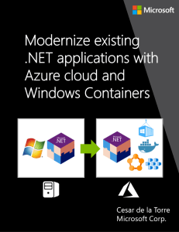
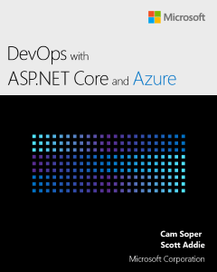
Get Help Migrating your .NET app to Azure
aka.ms/migratetothecloud
Download free e-books and assessment resources….
Apply for free assistance from the .NET team!

Slide 30
Demo: .NET Core 2.1
Notes:
File new --- show HTTPs is set up for you, GDPR “cookie” / UI / profile already set up -- Show scaffolded UI
Azure SignalR Service
-- 8min

Slide 31
Now Available .NET Core 2.2 Preview
https://aka.ms/DotNetCore22

Slide 32
.NET Core 2.2 Themes
Improved Web API Development
Microservices and Azure
Continued Performance Improvements

Slide 33
.NET Core 2.2 Major Features
.NET Core
Cosmos DB provider
Spatial extensions for SQL Server and SQLite providers
Reverse engineering of database views
Collections of owned entities
Query tagging
ASP.NET Core
Multi-tier JIT compilation
SQL Connection token auth
EF Core
Template updates: Bootstrap 4, Angular 6
Web API improvements, including API security
HTTP/2
IIS in-process hosting
Health checks
Endpoint routing
SignalR Java client

Slide 34
Demo: .NET Core 2.2
Notes:
HTTP/2, API security, show the meetup or GitHub API / show swagger
Bootstrap 4 template updates
Angular templates
-- 8min

Slide 35
.NET Core
3
2
.NET Core 3 expands supported workloads to include Windows Desktop, IoT & AI
.NET Core is perfectly suited for the requirements of cloud-native, cross-platform workloads
WEB
CLOUD
DESKTOP
IoT
AI
.NET CORE
.NET CORE 3
LIBRARIES
INFRASTRUCTURE
RUNTIME COMPONENTS
COMPILERS
LANGUAGES
Notes:
ANIMATED SLIDE – shows progression of entire .NET platform into .NET Core specific workloads.
.NET Core is our cross-platform, open source implementation of .NET and is perfectly suited for requirements of cloud-native, cross-platform services. We’ve made significant investments in the core performance as well as the web stack so that you can easily take advantage of cloud patterns and scale.
.NET Core 3 will expand on the supported workloads to include IoT, AI and Windows Desktop.

Slide 36
.NET Core 3.0 Themes
Desktop Workloads
& UI Interop
Artificial Intelligence & Machine Learning
Web App Development Productivity

Slide 37
Desktop Improvements
UI Framework Enhancements
XAML Islands - WinForms & WPF can host UWP
XAML Controls – WinForms & WPF browser and media UWP controls
High DPI fixes for WinForms
Access to all the Windows 10 APIs
Also available in next version of .NET Framework (4.8)

Slide 38
Why Windows Desktop on .NET Core?
Deployment Flexibility
Side-by-side support
Machine global or app local framework
Self-contained EXEs
Core runtime and API improvements
Performance
X
=

Slide 39


Update .NET Framework Apps
Modernize Desktop Apps with .NET Core 3
Highly compatible updates
Install .NET Core updates per your
needs
Existing App
.NET Framework 4.8
.NET Core 3
Windows-only
Windows-only
Cross-platform
Highly-compatible, targeted improvements, like last few releases
UWP
WEB
DATA
AI/ML
WPF
ASP.NET Core
EF 6
EF Core
ML.NET
Windows Forms
.NET STANDARD
.NET Framework support unchanged (supported for life of Windows)
Side-by-side support
Self-contained EXEs
XAML Islands - WinForms & WPF apps can host UWP controls
Full access to Windows 10 APIs
FEATURES IN BOTH FXs
Notes:
.NET Framework will continue with highly-compatible targeted improvements like the last few releases and support will remain unchanged. You will be able to retarget existing apps to 4.8 and gain these improvements.
When you’re ready to move to .NET Core 3 (to take advantage of SxS install, interop between desktop app frameworks, and .NET Core performance) you can retarget and rebuild your apps to .NET Core.

Slide 40
The Future of .NET Framework
.NET Framework is slowing down
Why? We want to stop breaking your apps!
Billions of installs. Getting much harder to release major features without compatibility issues
Can innovate much faster with .NET Core because of its side-by-side nature
We will continue to update
Many major product lines within Microsoft depend on .NET Framework
We will continue to update .NET Framework for years to come. High-compat features only.
Things like… new security protocols, bug fixes, Windows features, etc.
No changes to support policy
Support for 10 years (5 mainstream+5 custom) per Windows support policy for each release
.NET Framework will remain a Windows component and service policy is the same as Windows
Recommend new development on .NET Core

Slide 41
Demo: .NET Core 3 for Desktop Apps
Notes:
5 min

Slide 42
Experimental Blazor: .NET in the Browser
Build client-side Web UI in .NET
You don’t need to know AngularJS, React, Vue, etc.
Take advantage of stability and consistency of .NET
Runs in all browsers via WebAssembly
Native performance
Strongly typed on client and server
Requires no plugin or code transpilation
Share C# code with the client and the server

Slide 43
Razor Components (“server-side Blazor”)
Blazor programming model integrated into ASP.NET Core
Runs server-side on .NET Core
Handle client UI interactions using SignalR
Same code can run client-side on WebAssembly with no code changes
WebAssembly support remains experimental while runtime matures
Razor Components shipping in .NET Core 3.0

Slide 44
Demo: Blazor
Notes:
8min

Slide 45






Microsoft Cognitive Services
Commoditized AI
Vision
From faces to feelings, allow your apps to understand images and video
Speech
Hear and speak to your users by filtering noise, identifying speakers, and understanding intent
Language
Process text and learn how to recognize what users want
Knowledge
Tap into rich knowledge amassed from the web, academia, or your own data
Search
Access billions of web pages, images, videos, and news with the power of Bing APIs
Labs
An early look at emerging Cognitive Services technologies: discover, try and give feedback on new technologies before general availability
Notes:
Cognitive services uses pretrained models. These are super easy to use set of services for vision recognition, speech and text.

Slide 46
ML.NET
Machine Learning framework made for .NET developers
Build-your-own
Build your own custom models by writing C# or F# code
Developer focused
ML.NET provides just the right amount of productivity and control
Extensible
Tap into other machine learning toolkits with the rich extensibility model like TensorFlow
Proven
ML.NET has been used internally in products like Office and Bing for years
Open source and Cross-platform
Runs on Windows, macOS and Linux and developed in the open on GitHub
https://github.com/dotnet/machinelearning
Notes:
However for many specific domains you need to build and train your own models. ML.NET is built for .NET developers to do exactly that. ML.NET is a Machine Learning framework for .NET developers to build custom ML Models.
ML.NET is developer focused which means we are going to optimize for common developer scenarios like recommendation, sentiment analysis
ML.NET is based upon a decade of internal goodness
ML.NET is open source and cross-platform

Slide 47
A few things you can do with ML.NET …
Sentiment Analysis
Forecasting
Issue Classification
Predictive maintenance
Image classification
Recommendations
Object detection
Customer segmentation
And more! Samples @ https://github.com/dotnet/machinelearning-samples

Slide 48
New Preview Available ML.NET 0.6
https://aka.ms/MLNET06

Slide 49
Demo: ML.NET
Notes:
5min

Slide 50
Your platform for building anything
DESKTOP
WEB
CLOUD
MOBILE
GAMING
IoT
AI
.NET
www.dot.net
Notes:
So I hope what we showed you today reinforced our commitment to .NET for building anything you can imagine. It’s the best time to be a .NET developer and we have some very exciting innovations being made to the platform. The ecosystem is growing and it’s thanks to you! Please get involved and learn more on our website.

